Slide 1
SILC Member Orientation
Paving the pathways to full participation in communities
for people with disabilities
and supporting Colorado’s Centers for Independent Living.
01/2023

Slide 2
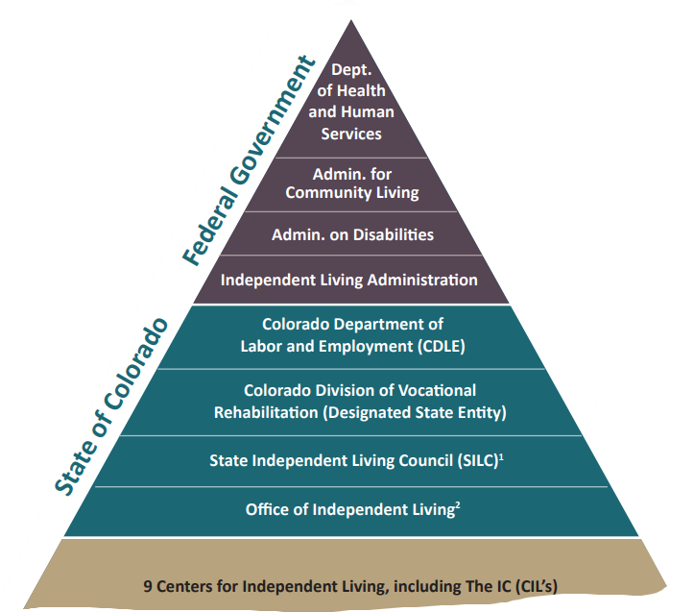
9 Independent Living Centers

Slide 3
Architectural Barriers Act (ABA) of 1968
Generally considered to be the first ever federal disability rights legislation
The ABA stands as the first measure by Congress to ensure access to the built environment for people with disabilities. The law requires that buildings or facilities that were designed, built, or altered with federal dollars or leased by federal agencies after August 12, 1968 be accessible.
https://www.access-board.gov/

Slide 4
1970 - Physically Disabled Students Program at Berkley
1970 - Urban Mass Transit Act – all new purchases lift equipped
1972 - Berkley Center for Independent Living opened
1973 - Rehab Act - federal contractors and programs receiving federal funds (Section 504 protects qualified individuals from discrimination based on their disability)
1974 – Ed Roberts becomes the Director of California DVR
1978 – Title VII of the Rehab Act funds CILs
1978 - "Gang of 19" activists occupy Denver intersection to protest inaccessibility on the city’s bus system
1982 – NCIL founded
1983 – ADAPT is organized
1984 – Voting Accessibility for the Elderly and Handicapped Act
1986 – Air Carrier Access Act
1990 – ADA and IDEA
1992 – Rehab Act authorizes Statewide Independent Living Councils
1998 – Workplace Investment Act
1999 – Olmstead
2010 – ADA Standards for Accessible Design
2014 – Achieving a Better Life Experience Act – ABLE accounts

Slide 5
The Rehabilitation Act of 1973
The Rehab Act of is a federal law, codified as 29 U.S.C. § 701 et seq.
The Rehab Act of 1973 replaces preexisting laws to extend and revise the authorization of grants to States for vocational rehabilitation services, with special emphasis on services to those with the most severe disabilities.
The Rehabilitation Act requires affirmative action in employment by the federal government and by government contractors and prohibits discrimination on the basis of disability in programs conducted by federal agencies, in programs receiving federal financial assistance, in federal employment, and in the employment practices of federal contractors.
President Richard Nixon signed H.R. 8070 into law on September 26, 1973 after he had vetoed two previous versions.

Slide 6
The Rehabilitation Act of 1973
Section 501 requires affirmative action and nondiscrimination in employment by Federal agencies of the executive branch.
Section 503 requires affirmative action and prohibits employment discrimination by Federal government contractors and subcontractors with contracts of more than $10,000.
Section 504 created and extended civil rights to people with disabilities. Section 504 has also provided opportunities for children and adults with disabilities in education, employment and various other settings. It even allows for reasonable accommodations such as special study area and assistance as necessary for each student. Each Federal agency has its own set of section 504 regulations that apply to its own programs. Requirements common to these regulations include reasonable accommodation for employees with disabilities; program accessibility; effective communication with people who have hearing or vision disabilities; and accessible new construction and alterations. Each agency is responsible for enforcing its own regulations. Section 504 may also be enforced through private lawsuits. It is not necessary to file a complaint with a Federal agency or to receive a "right-to-sue" letter before going to court.
Section 508 of the Rehabilitation Act establishes requirements for electronic and information technology developed, maintained, procured, or used by the Federal government. Section 508 requires Federal electronic and information technology to be accessible to people with disabilities, including employees and members of the public.

Slide 7
The Rehabilitation Act of 1973 Significant Amendments
Significant amendments were made 1974. The most important was the expansion of the definition of "handicapped individual." The original 1973 Act defined a "handicapped individual" as:
any individual who (A) has a physical or mental disability which for such individual constitutes or results in a substantial handicap to employment and (B) can reasonably be expected to benefit in terms of employability from vocational rehabilitation services.
The 1974 amendments substituted a much broader definition of "handicapped individual," and addressed architectural and transportation barriers (Section 502), employment by federal contractors (section 503) and programs receiving federal financial assistance (Section 504) not related to employability. The 1974 amendments said a handicapped individual meant:
any person who (A) has a physical or mental impairment which substantially limits one or more of such person's major life activities, (B) has a record of such an impairment, or (C) is regarded as having such an impairment.
Congress adopted that definition in the Americans with Disabilities Act of 1990, substituting the term "disability" for "handicapped."
In 1986, Public Law 99-506 helped the Rehabilitation Act to refine and focus services offered to those with the most severe disabilities. Supported employment was also defined as a "legitimate rehabilitation outcome".
Title four of the Workforce Investment Act of 1998 amended the Rehab Act in order to accomplish the goal of helping people return to the workforce. It also created a national council on disability. However, the Workforce Investment Act was repealed and replaced by the 2014 Workforce Innovation and Opportunity Act.

Slide 8
U.S. Department of Education
Welcome to RSA Rehabilitation Services Administration The Rehabilitation Services Administration (RSA) provides leadership and resources to assist state and other agencies in providing vocational rehabilitation and other services to individuals with disabilities to maximize their employment, independence, and integration into the community and the competitive labor market.
RSA.ed.gov
Connect to OSERS

Slide 9
The Workforce Innovation and Opportunity Act
In 2014, the WIOA transferred three programs to ACL from the U.S. Department of Education:
The Independent Living Services programs, which work to maximize the leadership, empowerment, independence, and productivity of individuals with disabilities and to integrate these individuals into the mainstream of American society.
The Assistive Technology Act programs, which exist to improve state’s abilities to improve access to assistive technology for people with disabilities.
The National Institute on Disability, Independent Living, and Rehabilitation Research (NIDILRR), which funds research and promotes practices to improve the capabilities of people with disabilities.

Slide 10
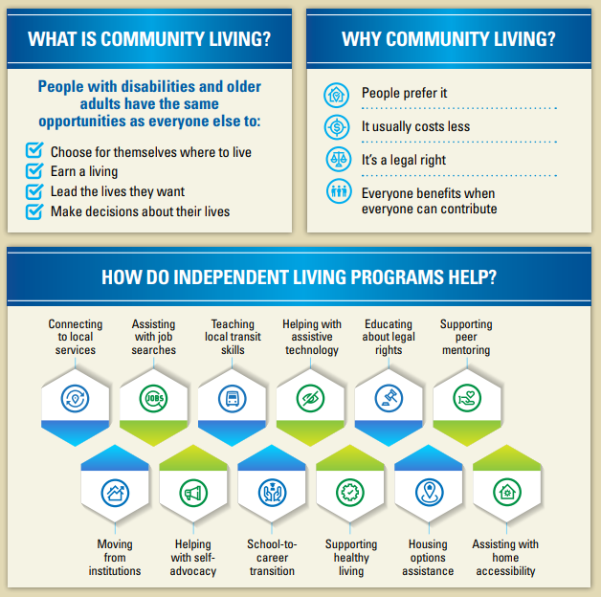
Advancing independence, integration, and inclusion throughout life
Authorizing Statutes
Developmental Disabilities Assistance and Bill of Rights Act of 2000
Older Americans Act
Workforce Innovation and Opportunity Act
Elder Justice Act
Health Insurance Portability and Accountability Act (HIPAA)
Help America Vote Act
Medicare Improvements for Patients & Providers Act
Public Health Service Act
Rehabilitation Act

Slide 11
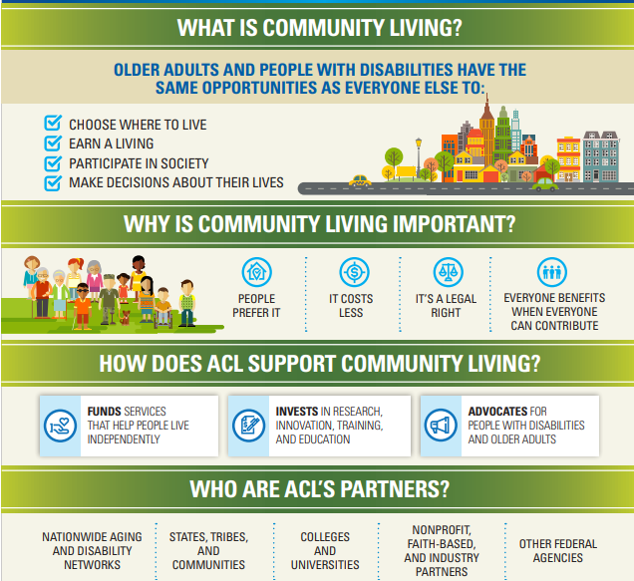
Independent Living Services (ILS) Program
List of Centers for Independent Living and State Plan for Independent Living by State
Policy and Regulations
Aging and Disability Networks
Region VIII: CO, MT, UT, WY, ND, SD
Percy Devine, Regional Administrator
1961 Stout St
Denver CO 80294-3638

Slide 12
Region 8 Representative: Joel Peden
Colorado, Montana, North Dakota, South Dakota, Utah, Wyoming
Mission: NCIL advances independent living and the rights of people with disabilities.
Vision: NCIL envisions a world in which people with disabilities are valued equally and participate fully.
The National Council on Independent Living is the longest-running national cross-disability, grassroots organization run by and for people with disabilities. Founded in 1982, NCIL represents thousands of organizations and individuals including: individuals with disabilities, Centers for Independent Living (CILs), Statewide Independent Living Councils (SILCs), and other organizations that advocate for the human and civil rights of people with disabilities throughout the United States.

Slide 13
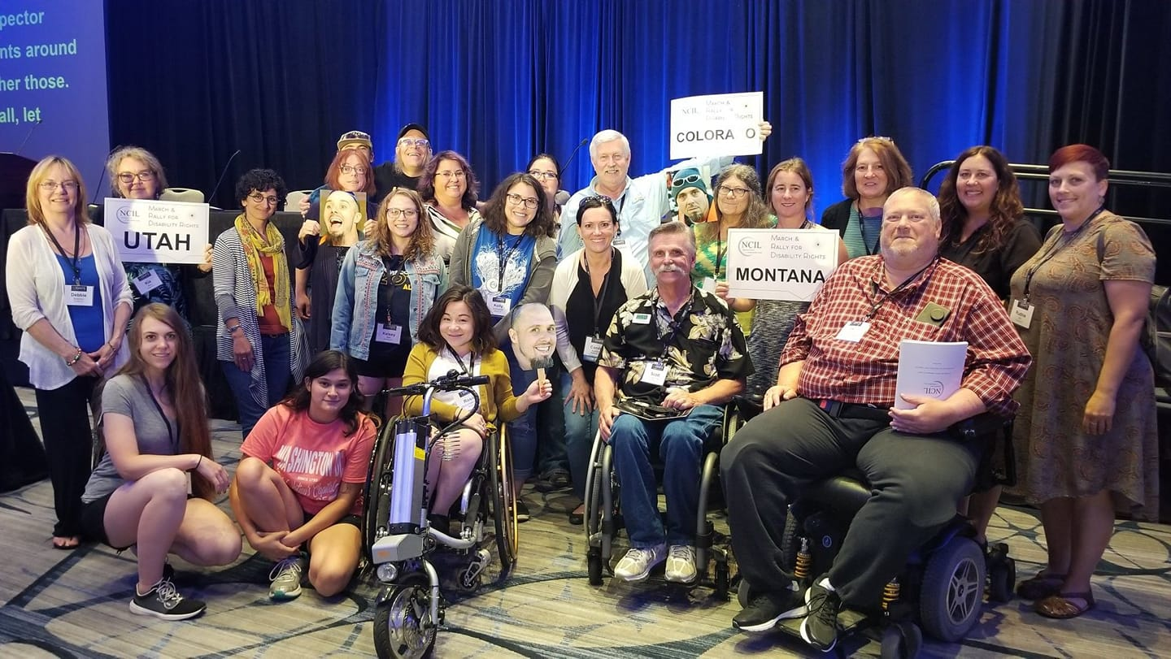

Slide 14
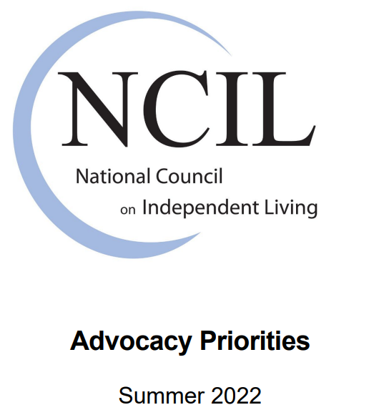
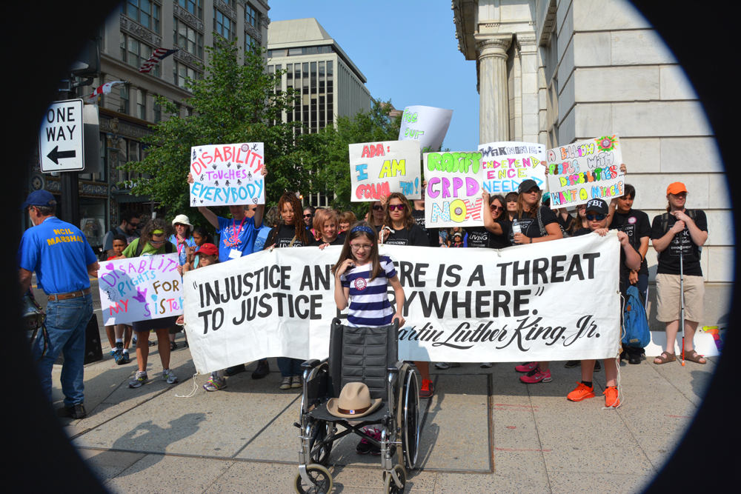
Advocacy Priorities Guide (PDF)
Advocacy Priorities Guide (Word)
Advocacy Priorities Guide (plain text)
Advocacy Priorities Guide (audio)

Slide 15
Independent Living Research & Utilization We create opportunities for independence for people with disabilities through research, education, and consultation.
Core Areas of Expertise
Centers for Independent Living (CILs)
CIL Disability, Diversity, & Intersectionality
CIL Business Acumen
Americans with Disabilities Act (ADA)
Collaborative on Health Reform & Independent Living (CHRIL)
Houston Livable Communities Initiative
Disaster Preparedness for People with Disabilities
Browse by Topic
Americans with Disabilities Act
Assistive Technology
CIL Core Services
IL Skills Training
Information & Referral
Institutional Transition & Diversion
Peer Counseling & Peer Support
Systems & Individual Advocacy
Transition of Youth
CIL Financial Management
CIL Management & Operations
Business Acumen
Consumer Information Files
Outcome Measures
PPR (704 Reporting)
Public Relations & Marketing
CIL Programs & Services
Disability Law & Olmstead Implementation
Emergency Preparedness
Gathering, Analyzing, & Utilizing Data
Health and Wellness
Home and Community-based Services
Managed Care
Personal Assistance Services (PAS)
Housing and Transportation
IL Administration
IL History & Philosophy
Inclusion, Diversity & Underserved Populations
SILC Operations
SILC Roles & Responsibilities
State Plan for Independent Living (SPIL)

Slide 16
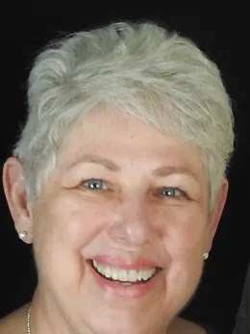
Paula McElwee
Blog
On-demand Training
Publications
For Statewide Independent Living Councils (SILCs):
ILRU offers peer group technical assistance discussions at 3pm Eastern for:
SILC staff and members (called SILCSpeak) - First Thursday of each month
Designated State Entities (DSEs) - scheduled quarterly
New CIL Directors - monthly
For one-on-one technical assistance, contact the IL-NET Associate Director of Technical Assistance, Paula McElwee at paulamcelwee.ilru@gmail.com or call 559-250-3082 (Pacific Time).

Slide 17
The Association of Programs for Rural Independent Living (APRIL) is a national grassroots, nonprofit membership organization consisting of over 260 members from centers for independent living, their satellites and branch offices, statewide independent living councils, other organizations and individuals concerned with the independent living issues of people with disabilities living in rural America.
APRIL advances the equity of people with disabilities in rural communities through advocacy, collaboration, shared experience, leadership development, education, and training.

Slide 18
AMERICAN DISABLED FOR ATTENDANT PROGRAMS TODAY
The Story of ADAPT

Slide 19
Colorado's Protection & Advocacy System and host agency for Colorado's Long-Term Care Ombudsman, PACE Ombudsman & Legal Assistance for the Elderly Programs
https://disabilitylawco.org/
Client Assistance Program

Slide 20
1-800-949-4232 ASL Deaf/HOH: (719) 358-2460 https://rockymountainada.org/
Meeting the Challenge, Inc, in Colorado Springs, is an accessibility compliance consulting firm that serves individuals and organizations with rights and responsibilities for compliance with federal disability rights laws. Meeting The Challenge has the broad-based knowledge, resources, and affiliate network to provide clients with solutions to solve their disability law compliance challenges and increase access for people with disabilities.

Slide 21
Free Online Training
Emergency Preparedness
Minimizing Implicit Bias
Readily Achievable Barrier Removal for Small Business
Service Animals and the ADA
Small Business and the ADA
Title I Overview
Title II Overview
Title III Overview
Web Content Accessibility Guidelines
2010 ADA Standards.
Accessible Recreation Facilities
Accessible Social Media
Accessible Voting Places
ADA History and Overview
Disability Awareness and Etiquette
Document Accessibility
Effective Communication and the ADA

Slide 22
Audits
Website Accessibility Audits
Parks and Recreation Audits
Training & On-Call Services
Facility Audits
Architectural Plan Review
Public Right-of-Way Audits
ADA Lawsuit Audits
Member of the ADA National Network
Customized Consultative Services
ADA Training
Telephone Consultation
Store
Research
Self-Evaluation and Transition Plans
Resources

Slide 23
National Association of Statewide Independent Living Councils (NASILC)
SILCs are federally mandated, so every state and territory in the US has a SILC.
SILCs operate independently of each other, but the Colorado SILC is part of a larger network of SILCs.
The purpose of each SILC is to determine the direction of the Independent Living (IL) Program for their state by identifying the needs of people with disabilities in partnership with their state’s Centers for Independent Living (CILs).
NASILC provides resources to SILCs across the nation and promote collaboration with their partners to advance IL values.
NASILC provides education and offer peer sharing on the roles and responsibilities of SILCs and to encourage networking opportunities with various national partners.
NASILC puts on the SILC Congress, which we send people to every year.

Slide 24
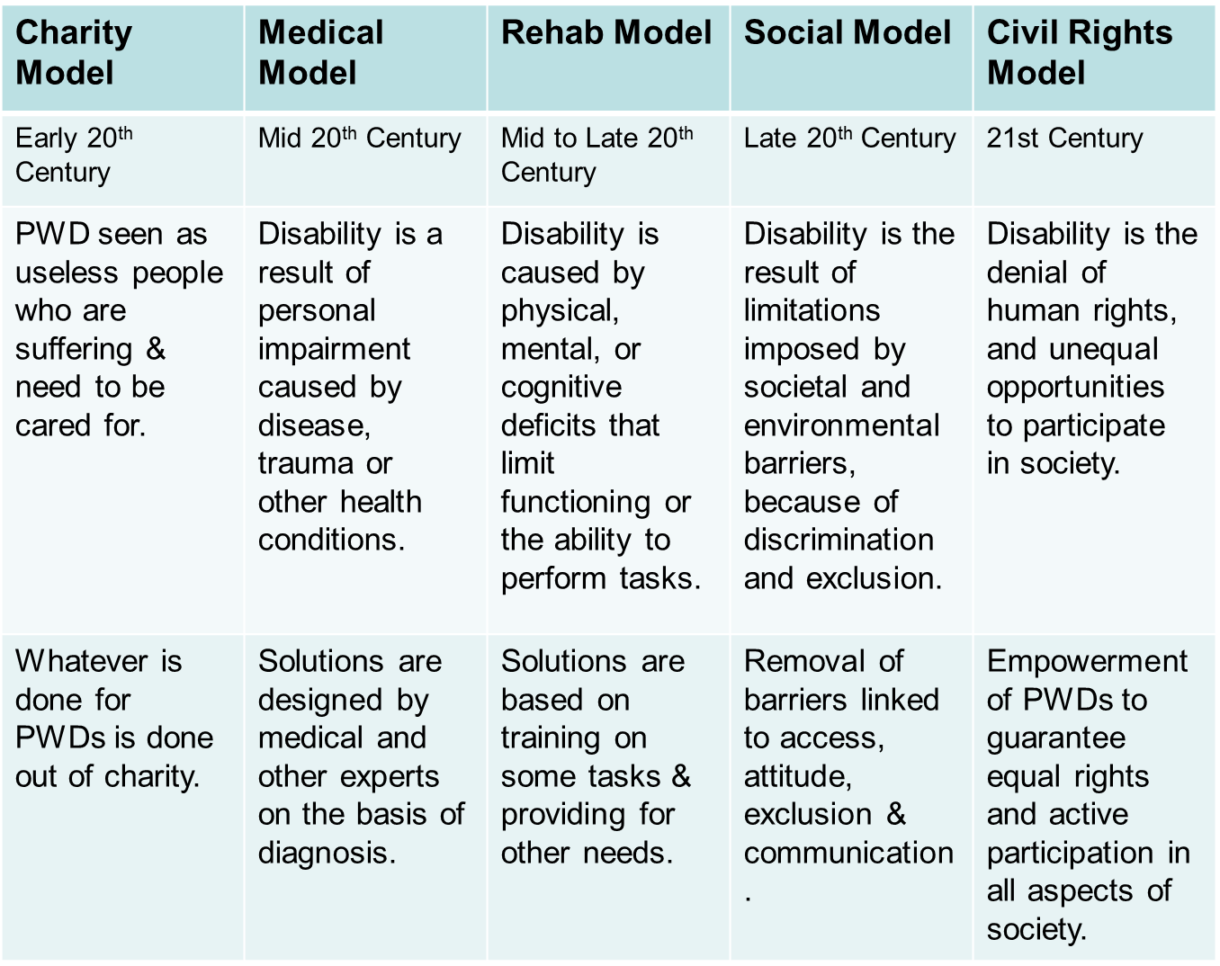

Slide 25
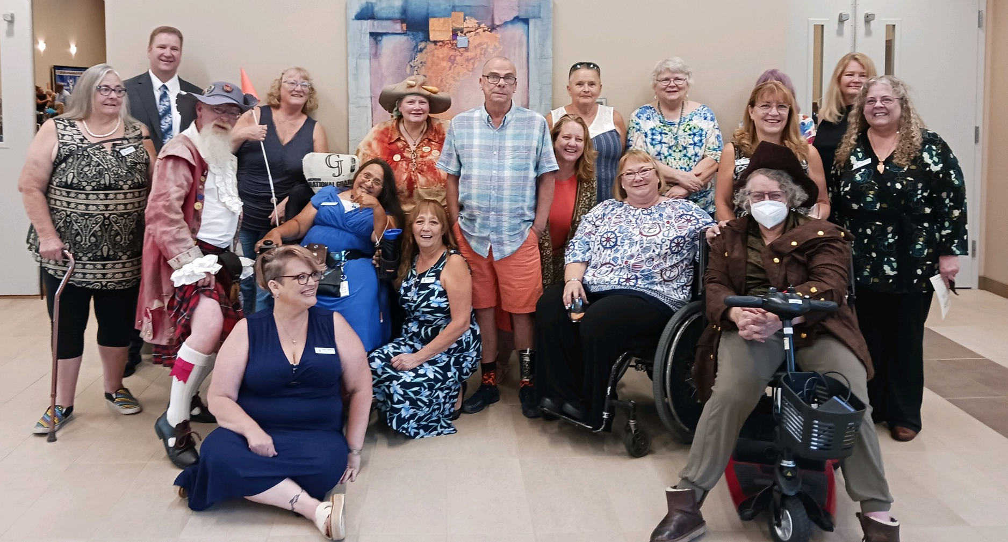
CIL Characteristics for Certification
Five Core Services
Information, Referral & Options Counseling
Advocacy – individual and systems
Independent Living Skills Training
Peer Support & Mentorship
Transition Services - LRE
Diversion from Institutionalization
Consumer-controlled
Community-based
Cross-disability
Non-residential
Promote philosophy of independent living

Slide 26
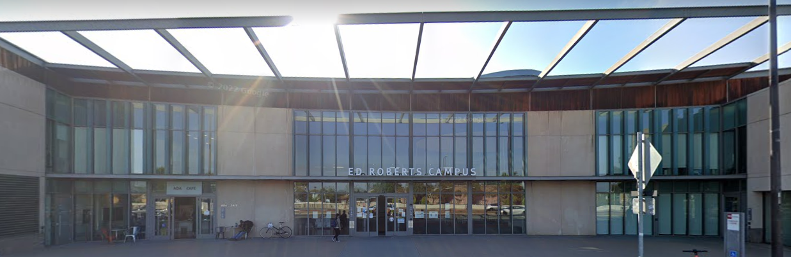
Centers for Independent Living
Each CIL is a separate private community based non-profit, operating independently of each other with their own Board of Directors, staff, By-Laws, operating budget and services.
All CILs must comply with federal mandates by providing five core services, have a Board and service staff of at least 51% people with disabilities, have diversified funding and maintain certification as a Center for Independent Living.

Slide 27
Independent Living Philosophy
Consumer Control
Integration
Peer Support
Advocacy
Self-Determination
Equal Access
Full Inclusion
Leadership
Self-Determination and Right to Risk
Control over my own life circumstances including making “bad” decisions
Direct my own services
“Person Centered” vs “Person Driven”

Slide 28
Colorado

Slide 29
ACCIL - The Association of Colorado Centers for Independent Living
The ACCIL is composed of the Directors of all of the Centers in Colorado. Each state has a similar network of CILs.
The ACCIL is a 501(c)4, and a portion of their money goes to lobbying.

Slide 30
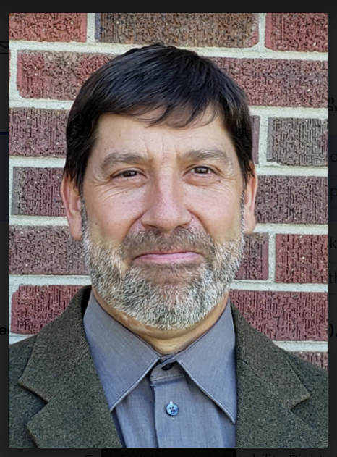
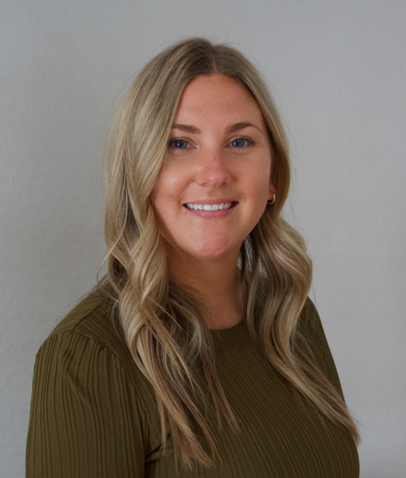
Colorado Office of Independent Living Services – Designated State Entity
The Office of Independent Living (Manager, Peter Pike) oversees compliance, represents the CILs at the state level, and provides support for fee for service activities and contracts.
Statewide Independent Living Council (SILC) indicators and Designated state Entity (DSE) Assurances required by WIOA

Slide 31
SILC Functions and Responsibilities
Promote systemic reform to remove barriers to independent living
Conduct research to inform policymakers and the general public
Be a resource for people with disabilities and the communities in which they live
Create the State Plan for Independent Living (SPIL) in collaboration with public and private stakeholders
Partner with Colorado’s network of Centers for Independent Living (CILs)
Work with the multiple groups that support independent living

Slide 32
Foundations
The Administration on Community Living (ACL) is the funder. The Colorado Department of Labor and Employment (CDLE) holds the contract for Part B money. The Colorado Office of Independent Living Services (the Office) within the DSE, administers the Part B funds, and the Office is our fiscal sponsor.
Part B funds are split between the Designated State Entity (DSE) which is the Division of Vocational Rehabilitation within CDLE, the SILC and the CILs.
When the SILC became a registered non-profit with the State of Colorado that enabled us to hold a contract with CDLE as a sole source entity. After the contract is finished and executed, the SILC will have the same relationship with the Office as the CILs.
ACL allows each state to operate per that state’s laws. For Colorado, that means the SILC operates under an Executive Order (EO) from the Governor. Our EO’s follow the Rehab Act and the Workforce Innovation and Opportunities Act (WIOA).
Each SILC, per the Rehab Act and WIOA, is governor appointed through that state’s Boards and Commissions.

Slide 33
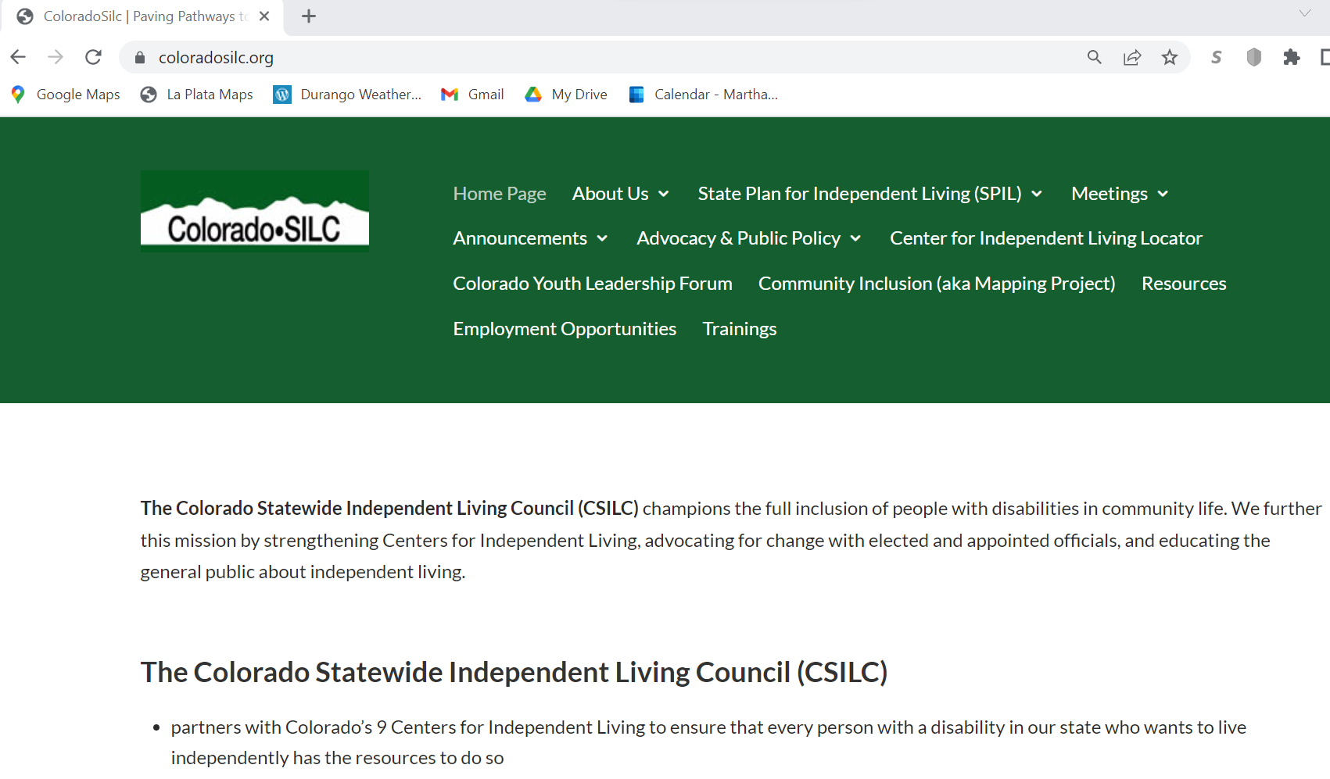

Slide 34
Funding for Centers
Part C: Federal funds that go straight to a CIL. In the 1980’s, the Federal Government put out an RFP to start Centers across the country. Centers that were awarded, submitted a bid to serve select counties for a set amount. Those RFP’s have been in place since the 1980’s. The only new Part C awards since then have been for exiting dollars that became available.
Part B: Federal funds that pass through the Designated State Entity (DVR in Colorado). They are allocated through a formula that is determined by the allocation committee and outlined in the State Plan for Independent Living (SPIL). The committee consists of 2 members from the SILC, 2 members from DVR, and 2 members from the CILs.
State General Funds: Money set aside by the Colorado legislation to fund Centers for Independent Living. All centers receive an equal base payment and additional monies determined by a formula.

Slide 35
Fiscal Year 2023
Sources | SILC | CILs | DSE
Title VII Chapter 1, Part B (including state match) | $101,615 | $220,166 | $16,935
Title VII Chapter 1, Part C | 0 | $1,257,196
Sec. 101(a)(18) of the Act (Innovation and Expansion) | $48,000
Colorado State General Funds |  | $6,800,847
OIB, SEEKS Grant, Other Grants, Fee-for-Service, etc. | Varies by Year | Varies by CIL

Slide 36
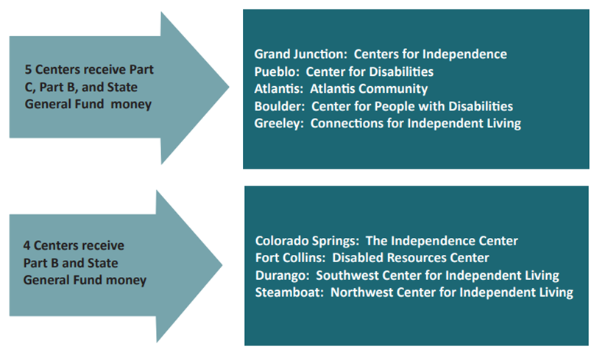

Slide 37
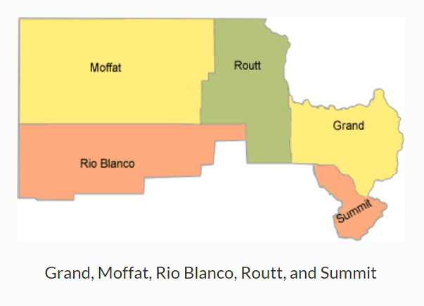
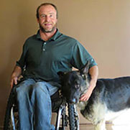
Ian Engle
Executive Director
ian@nwcci.org
‘Zuma’
Micheal Bertram
Assistant Director
micheal@nwcci.org
Part B Center
Steamboat Springs with satellite offices in Craig, Dillon, and Granby
https://www.nwcci.org/

Slide 38
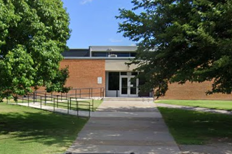
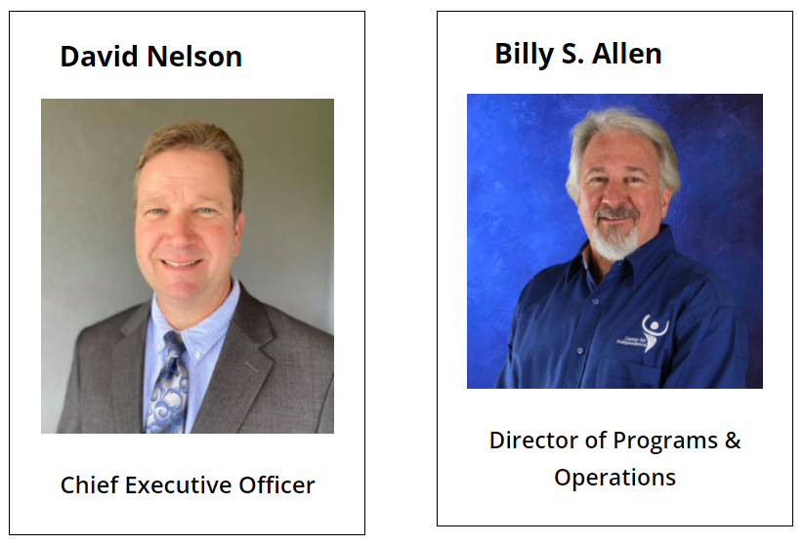
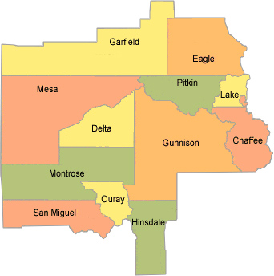
Part C Center
Grand Junction, with satellite offices in Glenwood Springs, Montrose, and Salida
https://cfigj.org/
Chaffee, Delta, Eagle, Garfield, Gunnison, Hinsdale, Lake, Mesa, Montrose, Ouray, Pitkin, and San Miguel

Slide 39
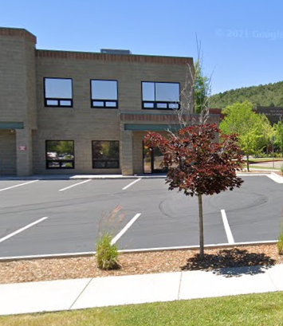
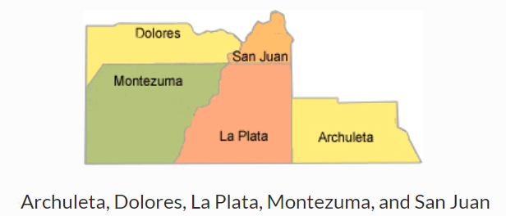
Kelsey Bell
Executive Director
Carli Hallis
Program Manager
Part B Center
Durango, with a Satellite Office in Cortez
https://swindependence.org/

Slide 40
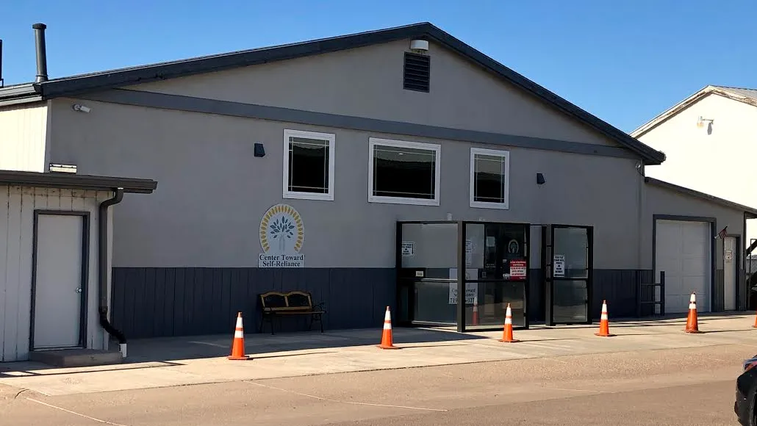
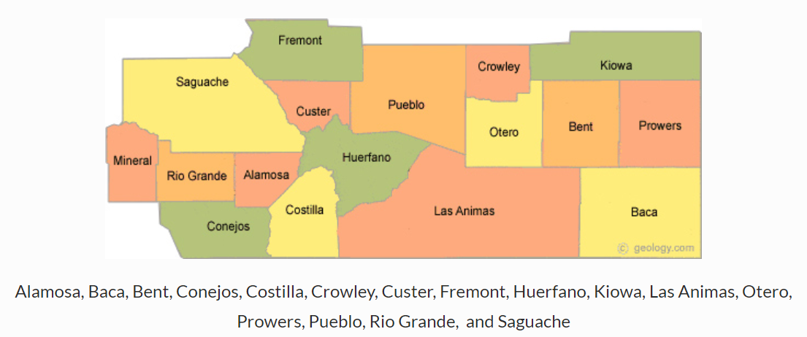
Part C Center
Pueblo, with satellites in Canon City, Alamosa, Lamar, and Trinidad
https://cfdpueblo.org/

Slide 41
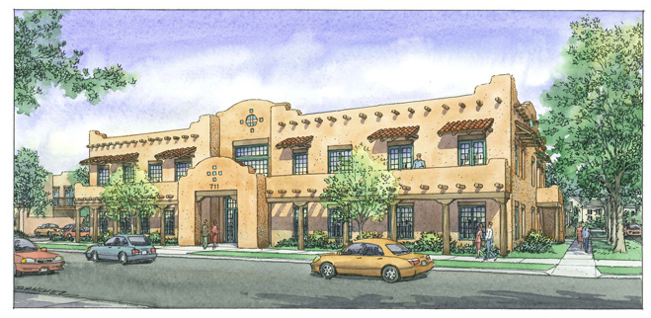
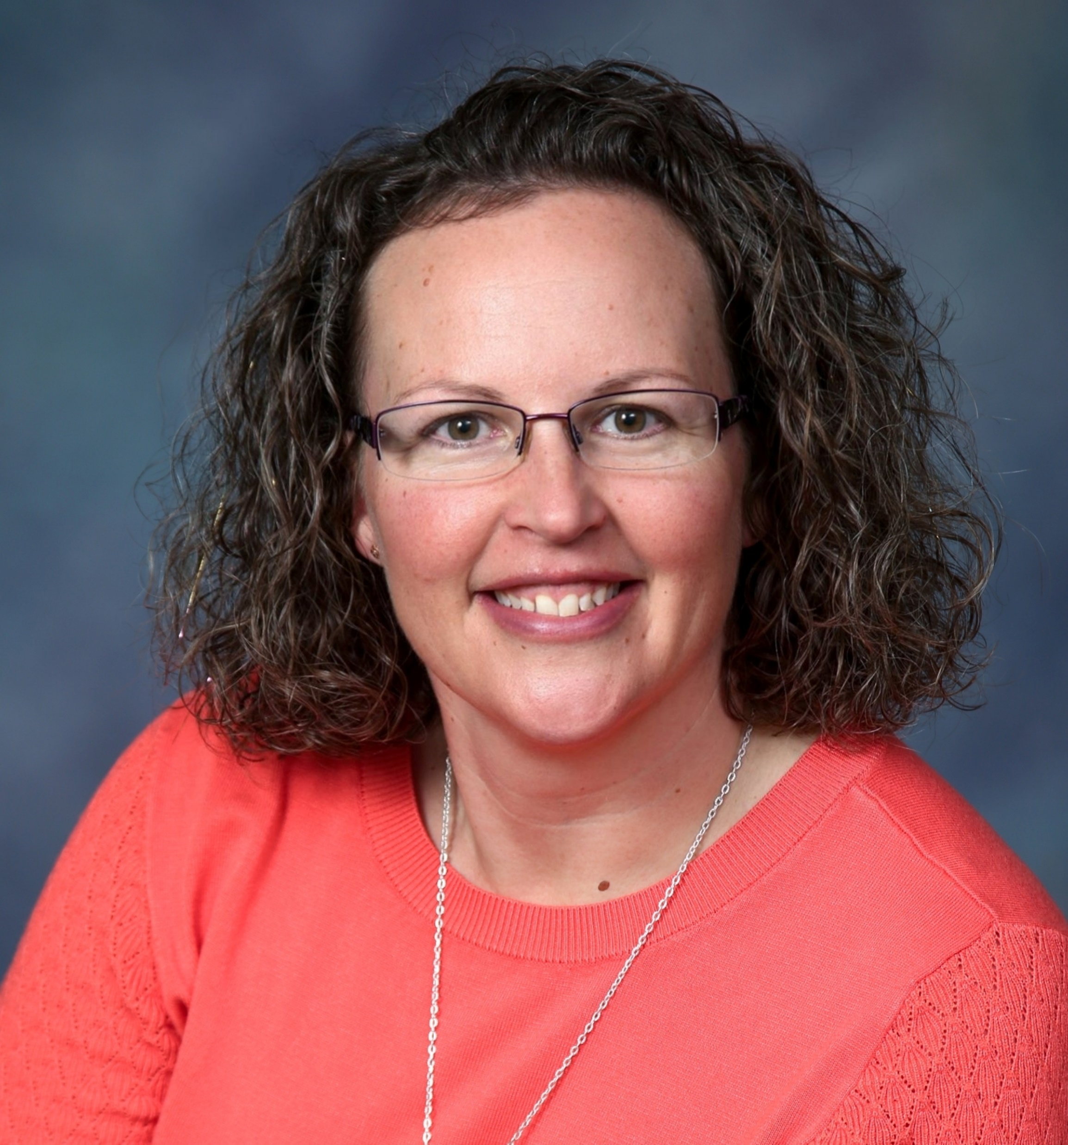
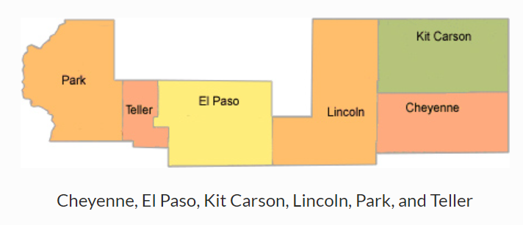
Indy Frazee
CEO
Mark Windle
Director of Independent Living
Part B Center
Colorado Springs, with satellites in Calhan, Cripple Creek, and Limon
https://www.theindependencecenter.org/

Slide 42
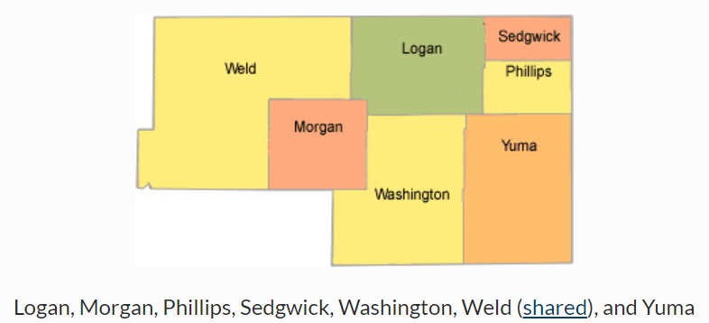
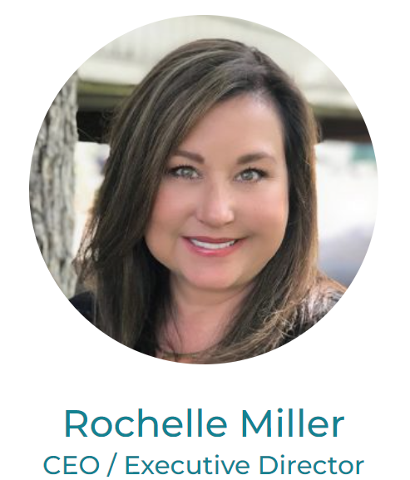
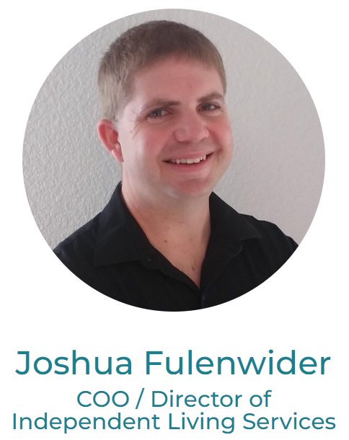
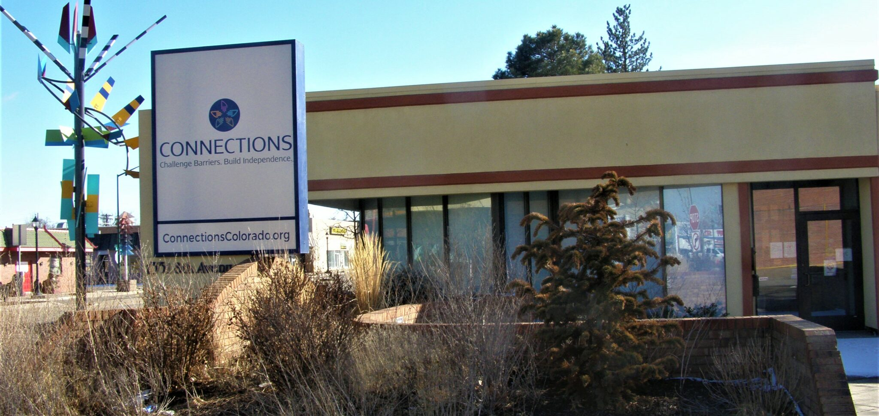
Part C Center
Greeley
https://www.connectionscolorado.org

Slide 43
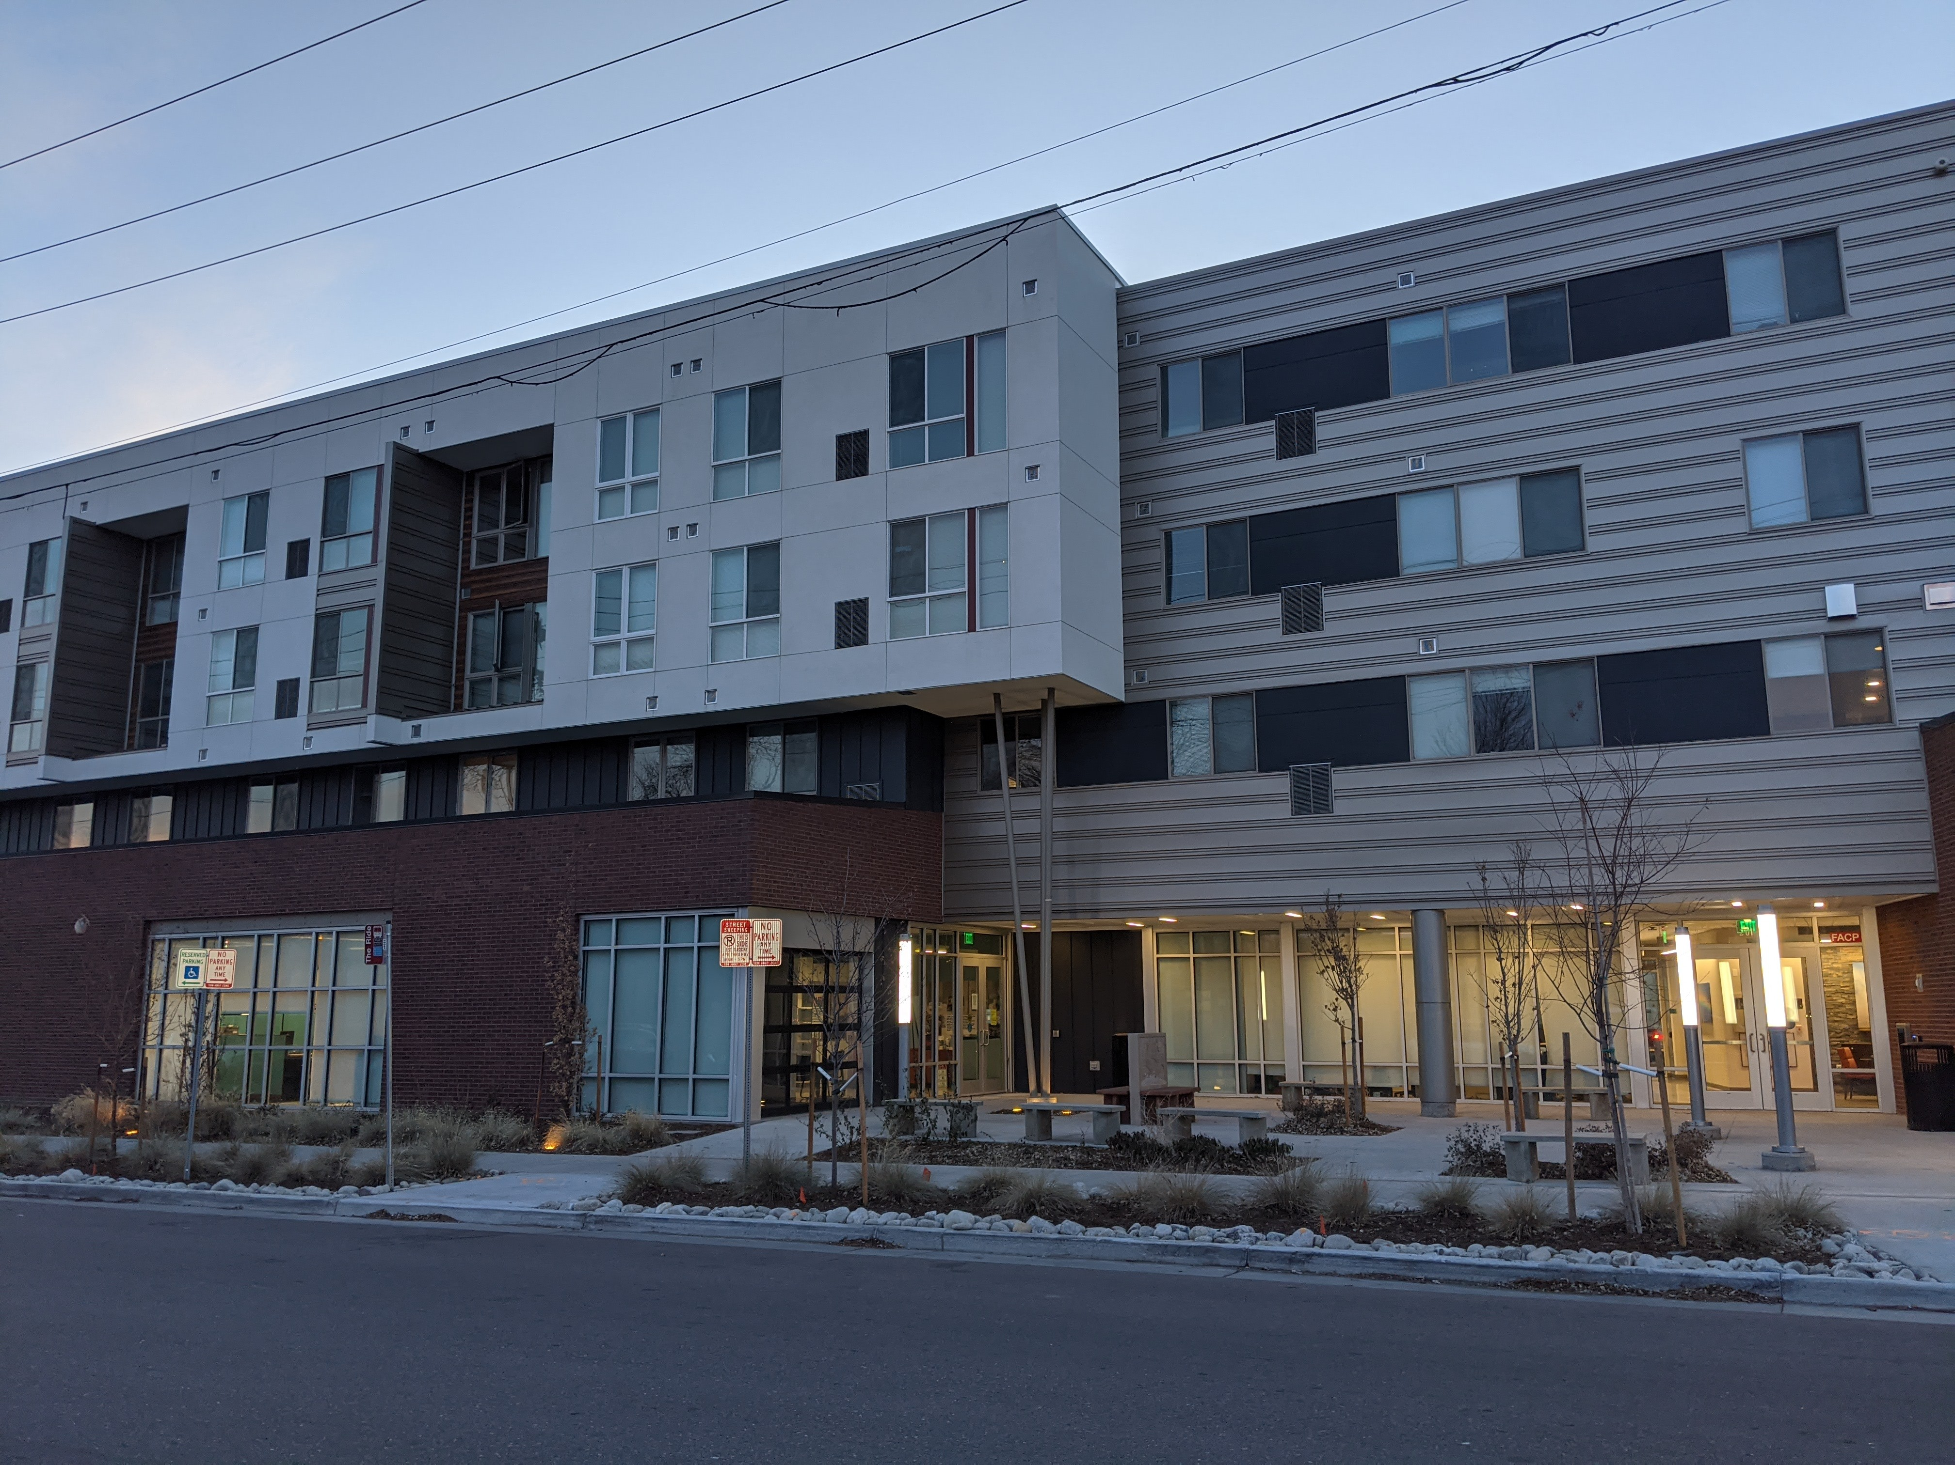
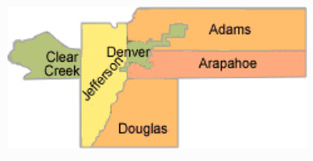
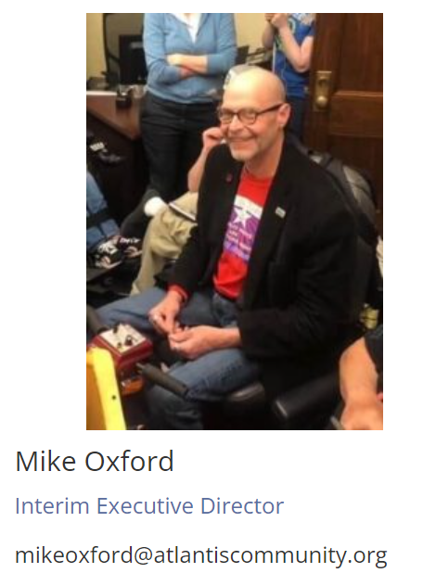
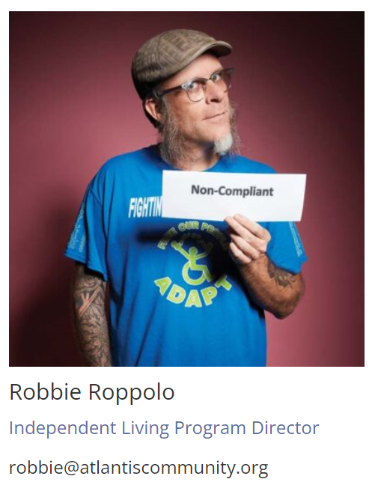
Part C Center
Adams (shared), Arapahoe, Clear Creek, Denver, Douglas, Elbert, and Jefferson (shared)
Denver
https://atlantiscommunity.org/

Slide 44
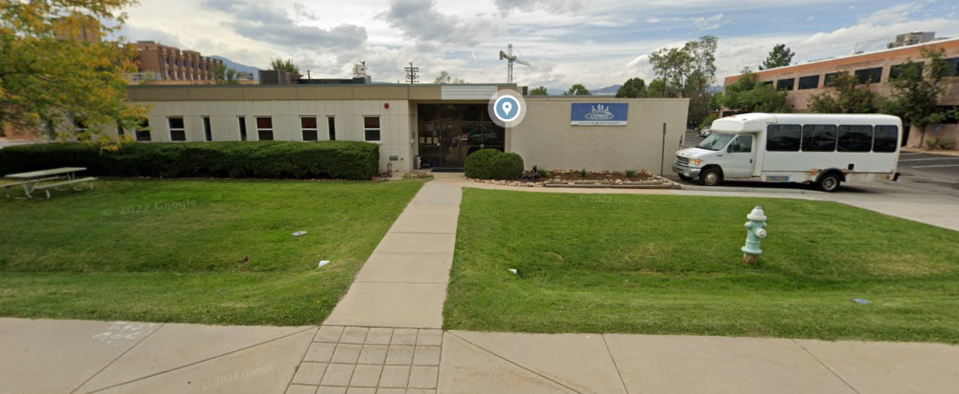
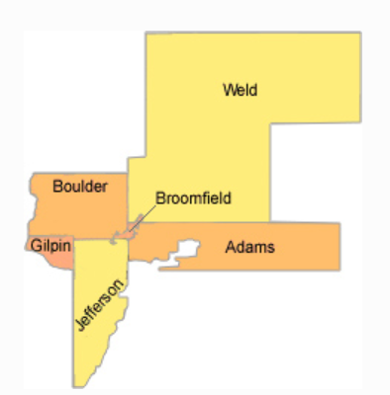
Center for People with Disabilities
Maria Stepanyan
Executive Director
Part C Center
Adams (shared), Boulder, Broomfield, Gilpin, and Jefferson (shared), Weld (shared)
Boulder, with satellites in Broomfield, Longmont, and Thornton
https://cpwd.org/
Heather Kamper
Director of Core Services

Slide 45
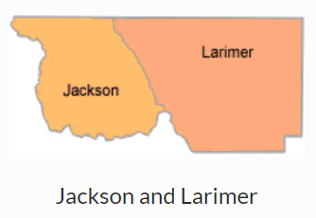
Denise Meyer
Executive Director
Part B Center
Ft. Collins, with a satellite office in Loveland
https://www.disabledresourceservices.org

Slide 46
Thanks for listening!
Questions?
Thoughts?
Welcome to the Colorado SILC! We are all so lucky to have you here.
Thank you in advance for your participation and your contributions that champion the full inclusion of people with disabilities in community life, and support Colorado’s Centers for Independent Living.

